Slide 1


Personal Budget Management System
Team 04: Gulnara Azizova, Aynur Yeganzada, Narmina Karimova, Farid Mehdiyev

Slide 2

What is Personal Budget Management System?
Helps users to control their finances and achieve financial goals
Provides visibility into spending
Making savings and planning for the future
Saving time

Slide 3
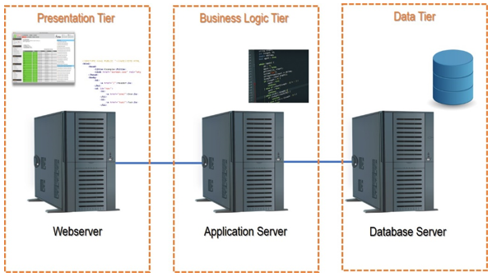
Architectural Design
Our team decide to go with the Client-Server architecture for these reasons:
- scalability
- security
- performance
Specially n-tiered Client-Server architecture:
Web server:
handling requests and responses from the user
Application server:
executing the business logic(calculating budgets,
generating reports.
Database server:
storing and retrieving financial data
(account balances, transaction histories,
and budget plans)

Slide 4
Component No. 1:
Authentication and
Authorization
Component state: User’s full name, email(or phone) username, password, security settings.
Component behavior: Verifying user’s identity, giving appropriate permissions to access the system.
Component No. 2:
Transaction Processing
Component state: Transaction amount; date, vendor, expense categories.
Component behavior: Categorizing the transaction based on the type of expense, updating the user balance

Slide 5
Component No. 3:
Component state: User profiles, budget data, transaction data, report history.
Component behavior: Import/export of data, data recovery.
Data Storage
Reporting and Analytics
Component state: Expense limits, time periods
Component behavior: Generating reports, charts, graphs for different time periods.
Component No. 4:
Notification
Component state: Alert options(on/off), categories and limits data.
Component behavior: Notifying the user when the limit exceeded via SMS or email
Component No. 5:

Slide 6

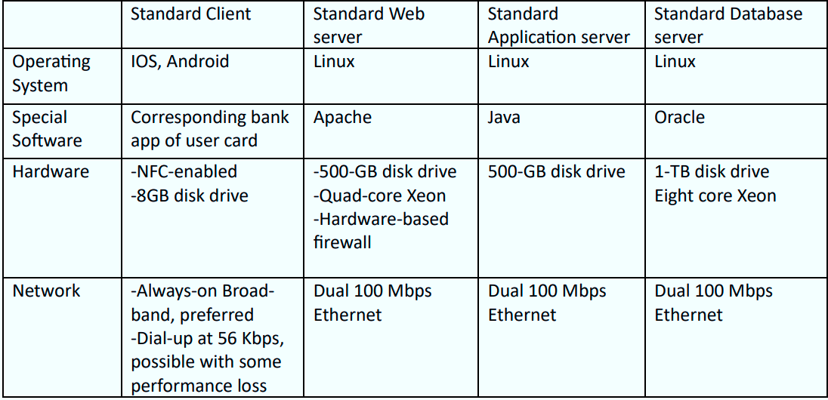
Hardware & Software Specifications

Slide 7
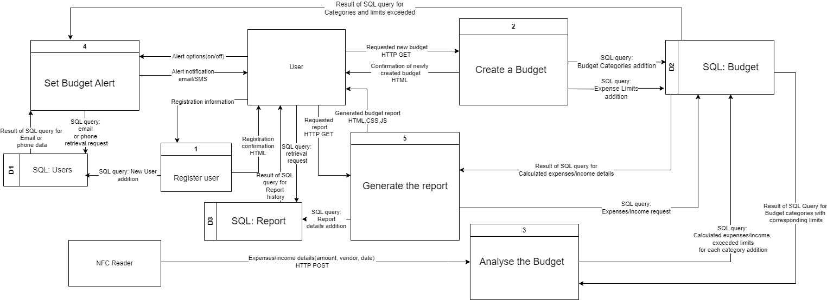
Program Design
Physical DFD

Slide 8
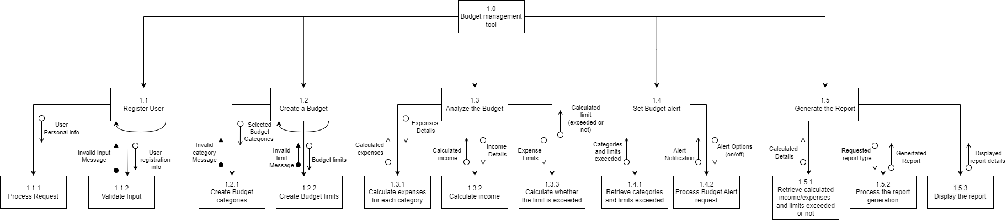
Program Design
Structure Chart

Slide 9
Structure Chart

Slide 10
Structure Chart

Slide 11
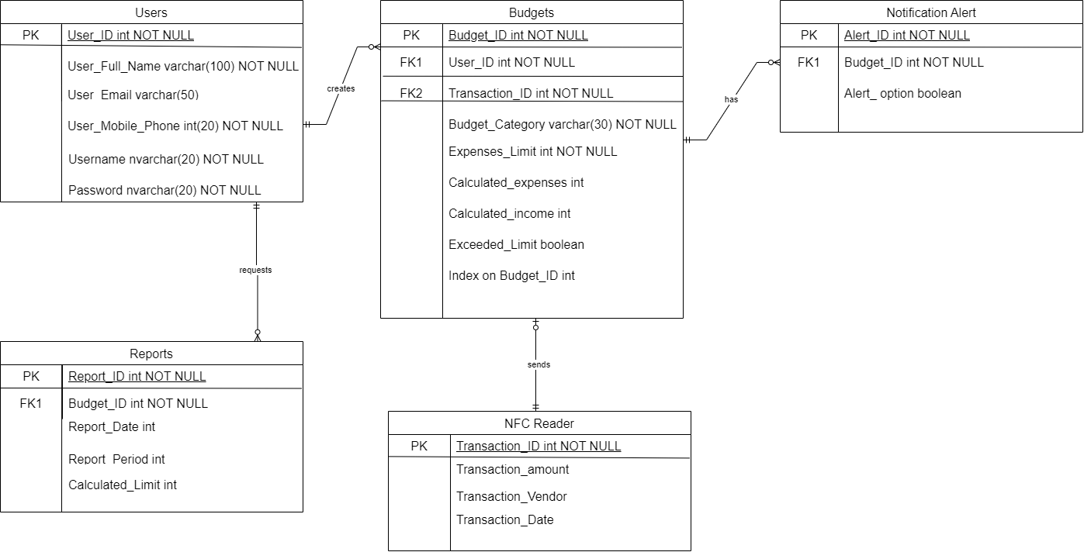
Data Storage Design

Slide 12
System-related Components
Relational database:
• Data Integrity
• Scalability
• Data Security
• Data Consistency
• Querying and Reporting
5 tables:
Users, Budgets, Reports, Notification Alert, NFC Reader
Indexing on Budget ID:
• Faster Data Retrieval
• Efficient Query Processing
• Improved Performance
• Data Consistency

Slide 13
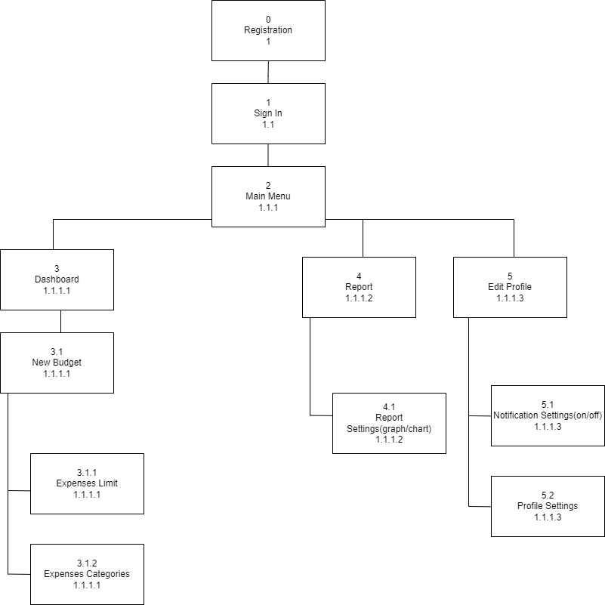
Interface Structure Diagram

Slide 14
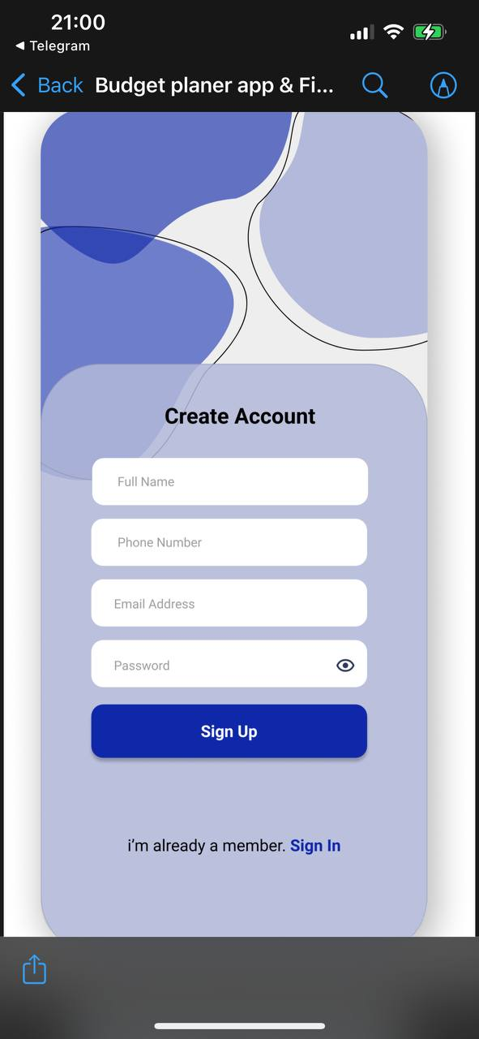
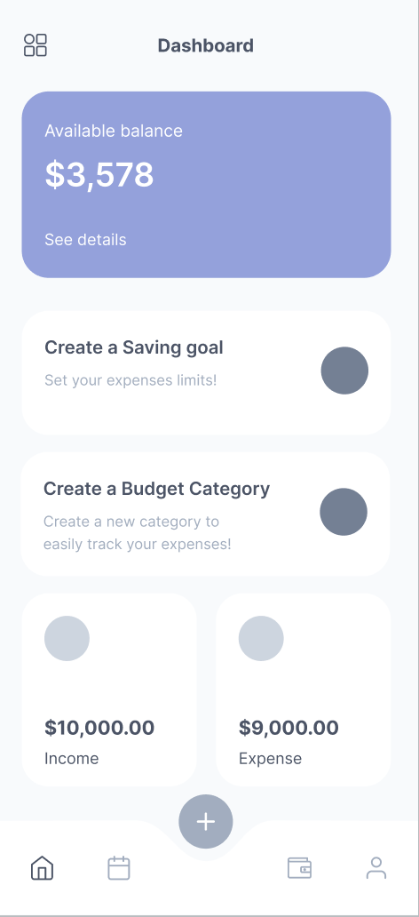
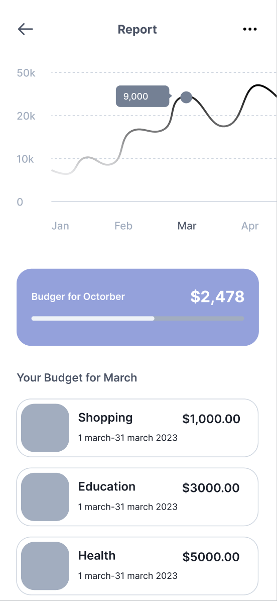
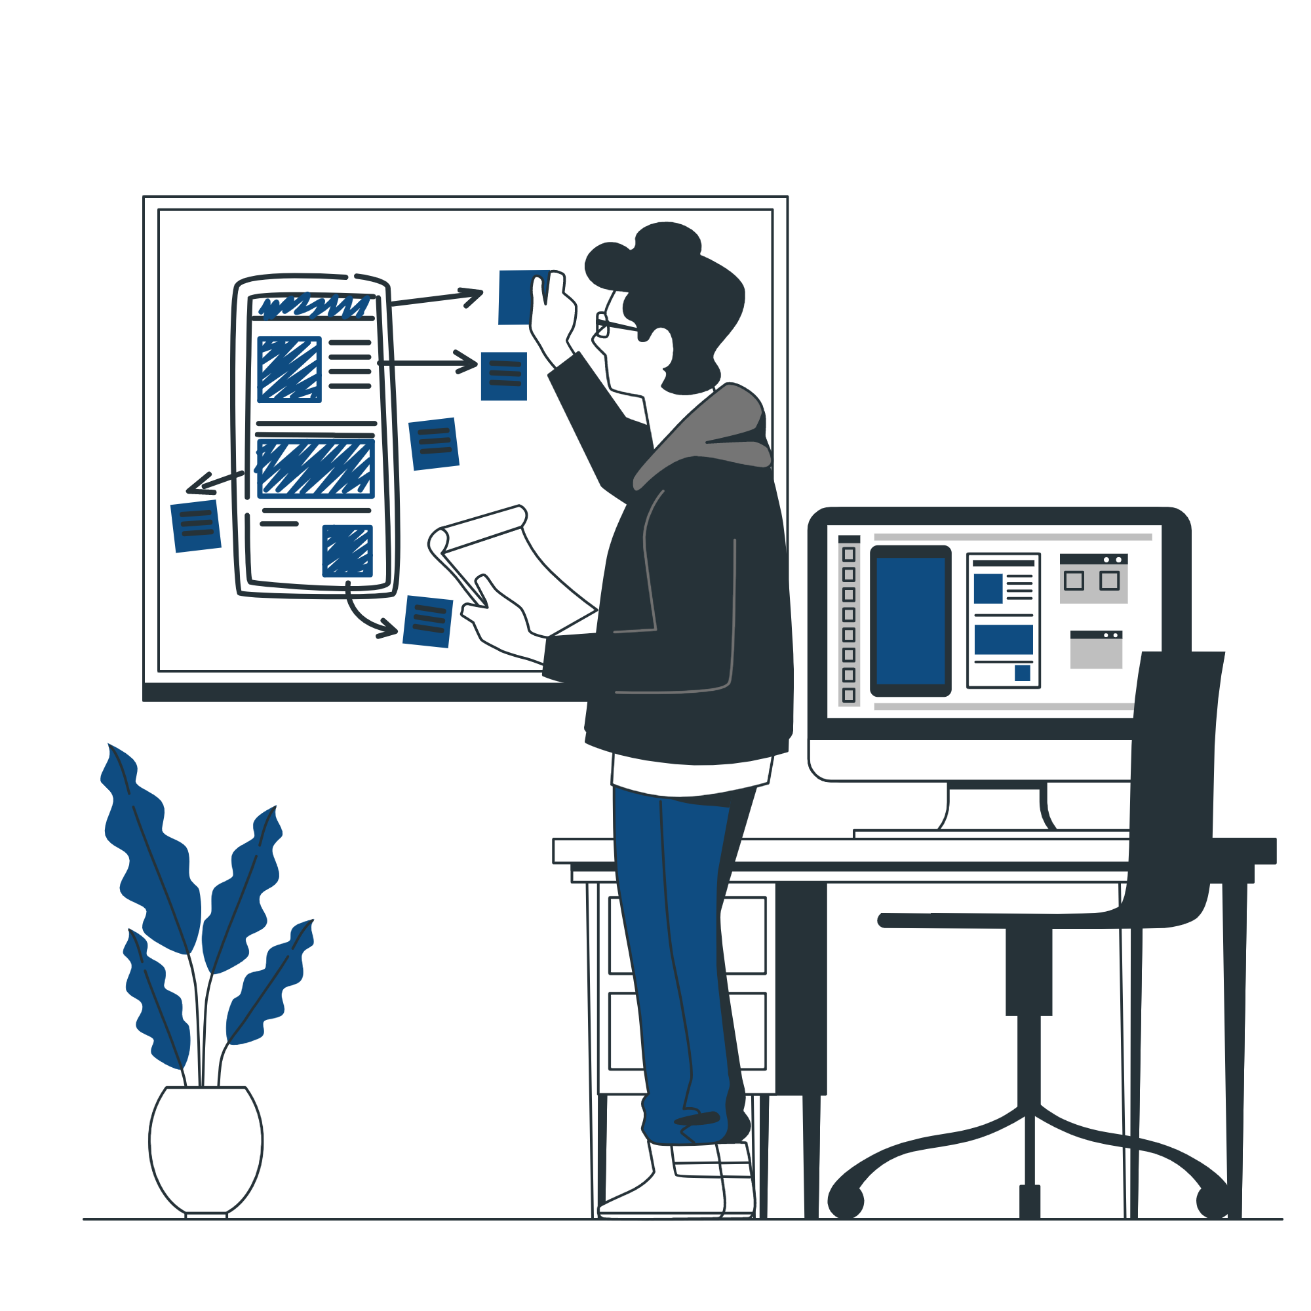
Prototyping

Slide 15
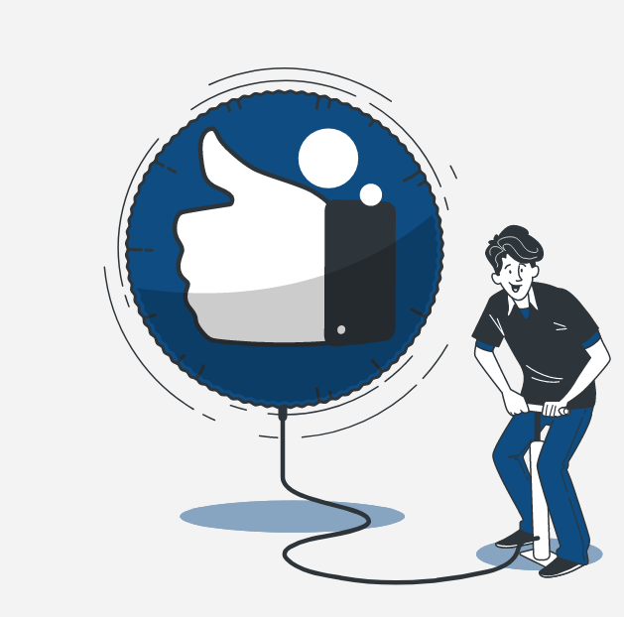
THANKS!

